Slide 1
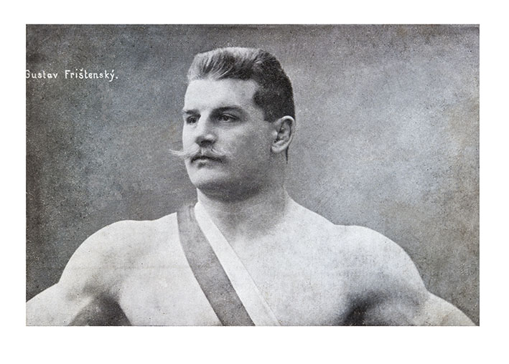
Mixing exercises

Slide 2

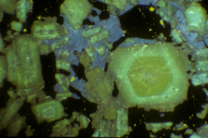
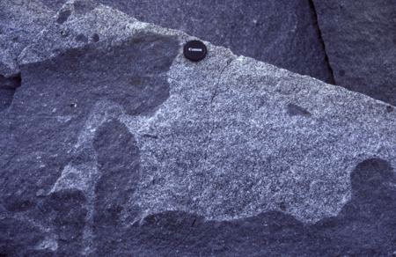

21.2: Major-elements based mixing test
Exercise
In the CBPC, Amp and Cpx-bearing monzonites and monzogabbros are associated with the Kozárovice granodiorite (Janoušek et al. 2000). In addition, the granodiorite contains small net-veined bodies and enclaves of Bt–Amp quartz monzonite.
 | 1: granodiorite | M: quartz monzonite | 2: monzogabbro
SiO₂ | 64.60 | 59.58 | 49.21
TiO₂ | 0.57 | 0.72 | 1.02
Al₂O₃ | 14.99 | 14.8 | 13.69
Fe₂O₃ | 1.27 | 1.69 | 2.47
FeO | 2.79 | 4.08 | 6.96
MnO | 0.08 | 0.14 | 0.15
MgO | 2.37 | 4.11 | 8.53
CaO | 3.44 | 5.33 | 9.74
Na₂O | 3.12 | 2.84 | 1.89
K₂O | 4.34 | 4.19 | 3.61
kozamix.data
Test whether the quartz monzonite (M) could correspond to a hybrid between granodiorite (1)
and monzogabbro (2).
Determine the proportion of granodiorite in the mixture.

Slide 3
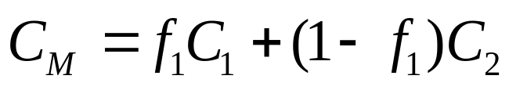
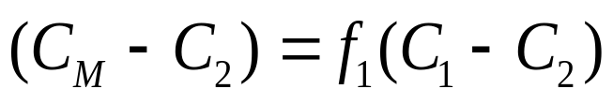
21.2: Major-elements based mixing test
From mixing equation [6.23]:
Eq. [21.13]
In R, the least-squares method is implemented by the function lsfit setting intercept = FALSE, so that the model passes through the origin.

Slide 4
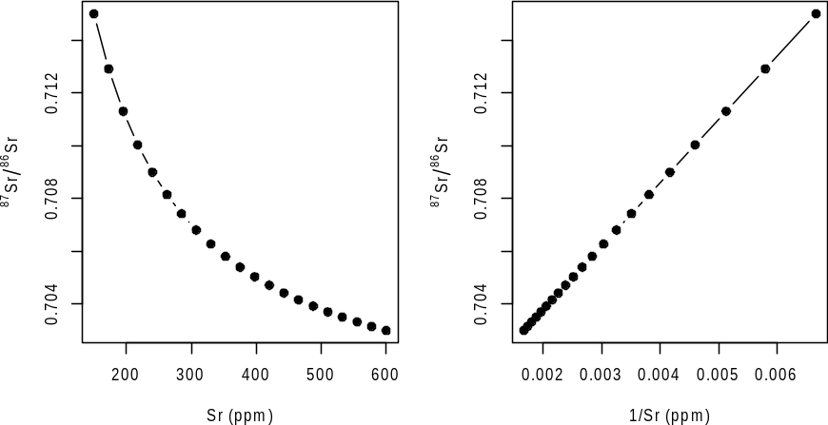
18.1: Single isotopic ratio (direct mixing)
Exercise
During its ascent, a basaltic magma is contaminated by a host-rock schist.
 | A: schist | B: basalt
Sr | 150 ppm | 600 ppm
⁸⁷Sr/⁸⁶Sr | 0.715 | 0.703
Plot a theoretical mixing hyperbola between basalt and schist in the Sr–⁸⁷Sr/⁸⁶Sr and 1/Sr–⁸⁷Sr/⁸⁶Sr diagrams for 5% mixing increments.
Calculate the ⁸⁷Sr/⁸⁶Sr ratio in a mixture containing 20 % of the schist.
Determine the proportion of schist in the mixture that has ⁸⁷Sr/⁸⁶Sr = 0.710.

Slide 5
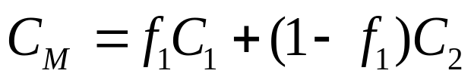
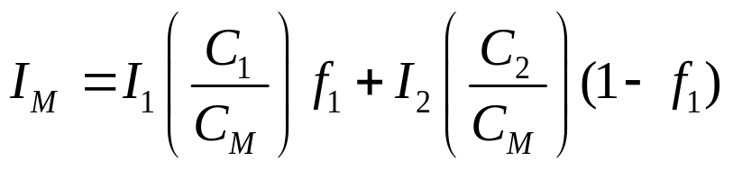
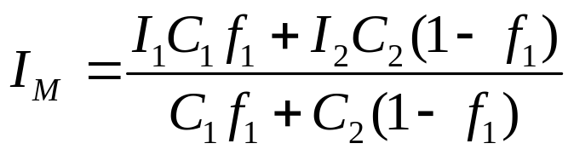
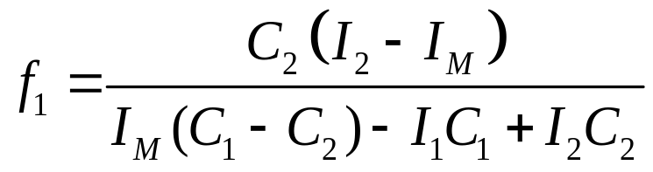
18.1: Single isotopic ratio (direct mixing)
Eq. [16.2]
Eq. [16.1]
Eq. [16.3]
Eq. [16.5]

Slide 6
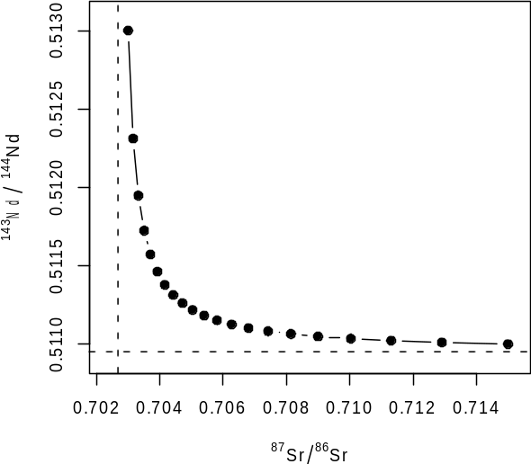
18.2: Pair of isotopic ratios
(direct mixing)
Exercise
A basaltic magma is contaminated by a host-rock schist. However, here, both Sr and Nd isotopic data are available.
 | A: schist | B: basalt
Sr | 150 ppm | 600 ppm
⁸⁷Sr/⁸⁶Sr | 0.715 | 0.703
Nd | 20 ppm | 2 ppm
¹⁴³Nd/¹⁴⁴Nd | 0.511 | 0.513
Calculate the Sr (ppm), ⁸⁷Sr/⁸⁶Sr, Nd (ppm) and ¹⁴³Nd/¹⁴⁴Nd of mixtures containing 0, 5, 10, … 100 % of the schist; print the result in a table.
Plot a theoretical mixing hyperbola in the ⁸⁷Sr/⁸⁶Sr – ¹⁴³Nd/¹⁴⁴Nd space.
Calculate and plot the asymptotes.

Slide 7
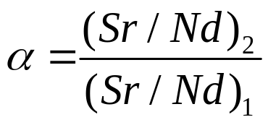
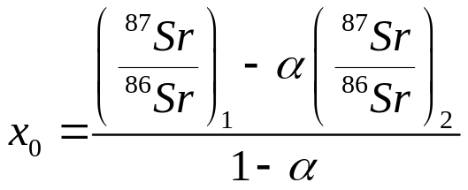
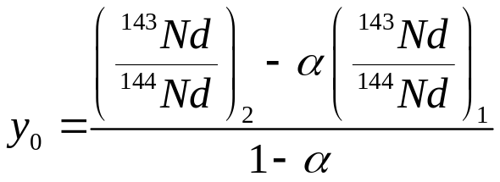
18.2: Pair of isotopic ratios
(direct mixing)
Eq. [16.2]
Eq. [16.1]
Eq. [16.8]
Asymptotes:
Eq. [16.14]

